Slide 1
Grasp and Lift
EEG Detection
NCU CSIE
109502551 Rong-Xuan, Ye

Slide 2
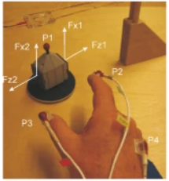
Introduction
Classify different motion phase through EEG signal.
6 motion phase:
HandStart
FirstDigitTouch
BothStartLoadPhase
LiftOff
Replace
BothReleased

Slide 3
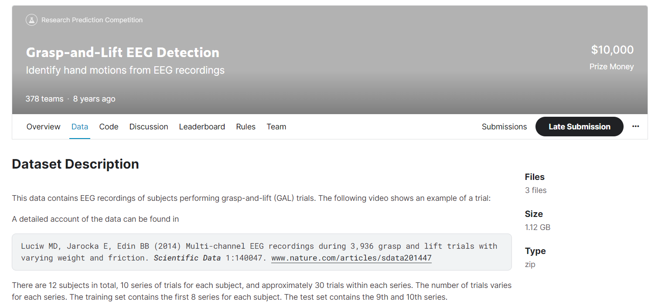
Introduction
Data set is from Kaggle.
12 subjects in total
10 series of trials for each subject
approximately 30 trials within each series

Slide 4
Goal
My goal for this project when project pitch
Achieve at least 80% accuracy
Leran how to implement different method for EEG signal detection

Slide 5
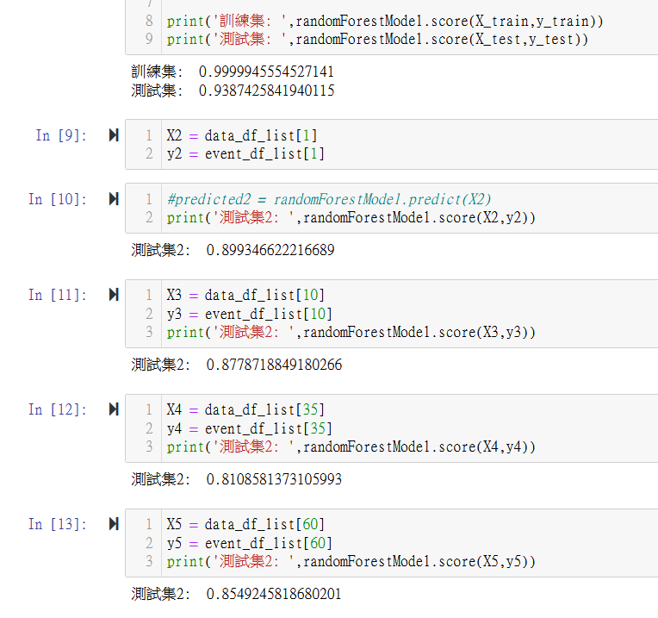
Result
Method: PCA and Random Forest
Accuracy:
99% for train data (subj1, series1)
80%~93% for test data
Test data includes different subject
and series.
However, there must be something wrong.

Slide 6
What I Learn and Practice
PCA and ICA
Before:
I just know PCA and ICA is common used in signal decomposition
Now:
I know how they work, and how to implement them by python

Slide 7
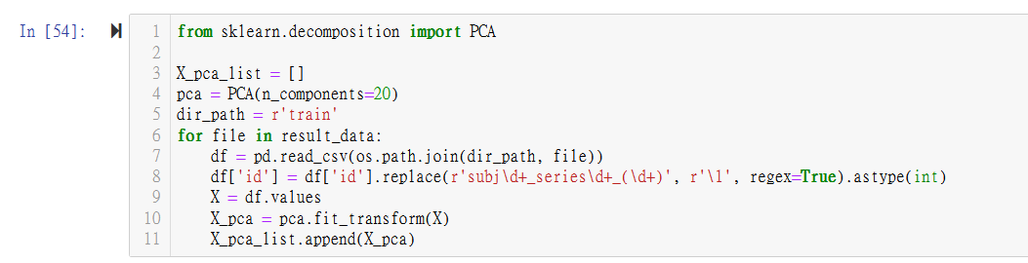
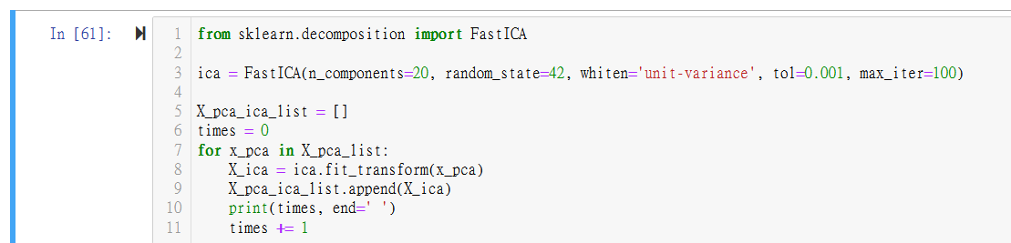
What I Learn and Practice
PCA and ICA
Some problem:
After ICA, I cannot determine which component should be discard.

Slide 8
What I Learn and Practice
MNE python
Before:
I have witnessed a teacher demonstrating the usage of mne python,
but I have never personally worked with it.
Now:
I know how to manipulate with BID data, and try to use csv file to create info by myself

Slide 9
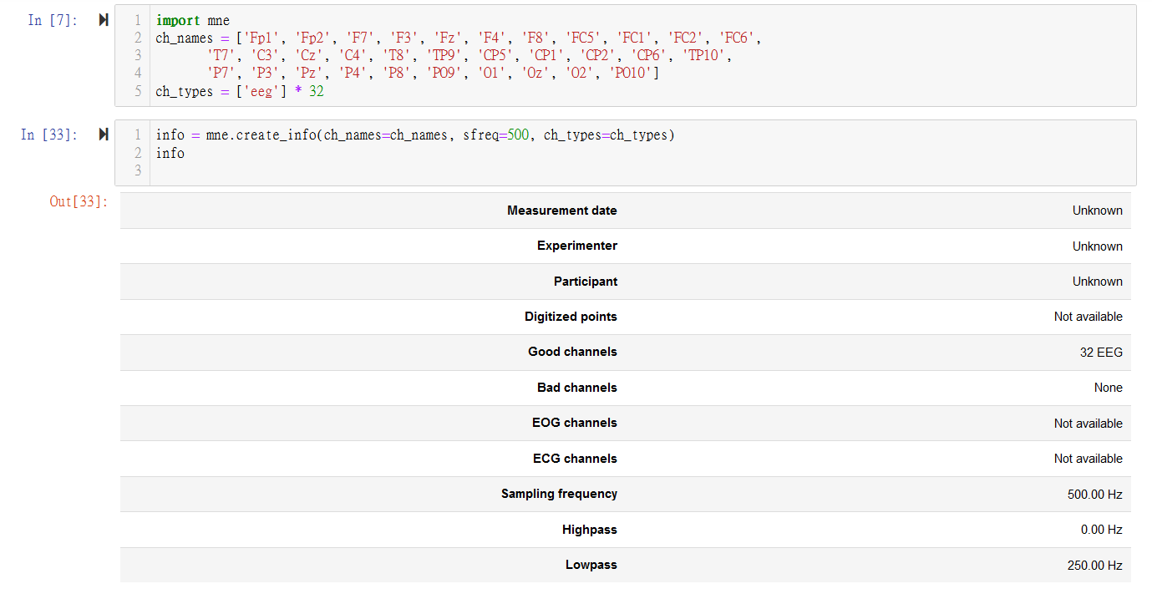
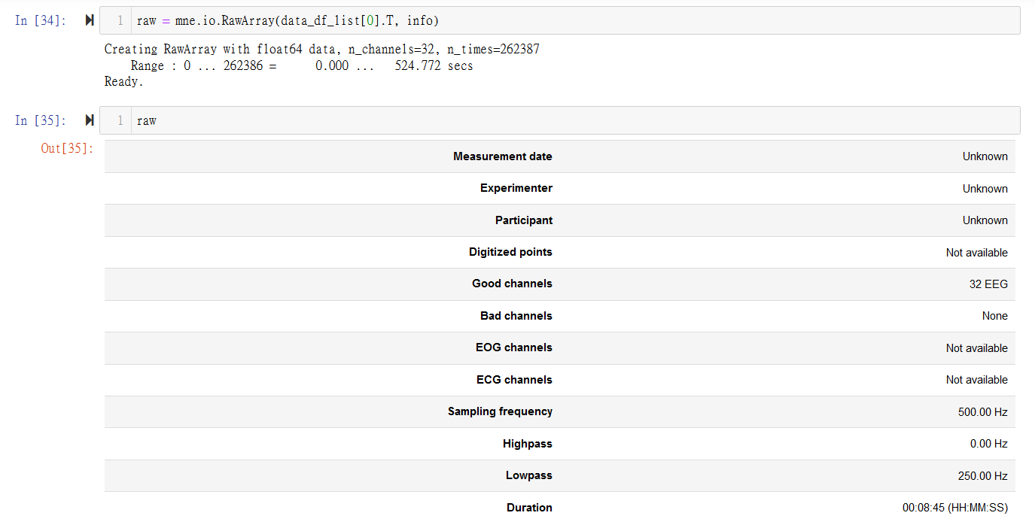
What I Learn and Practice
MNE python

Slide 10
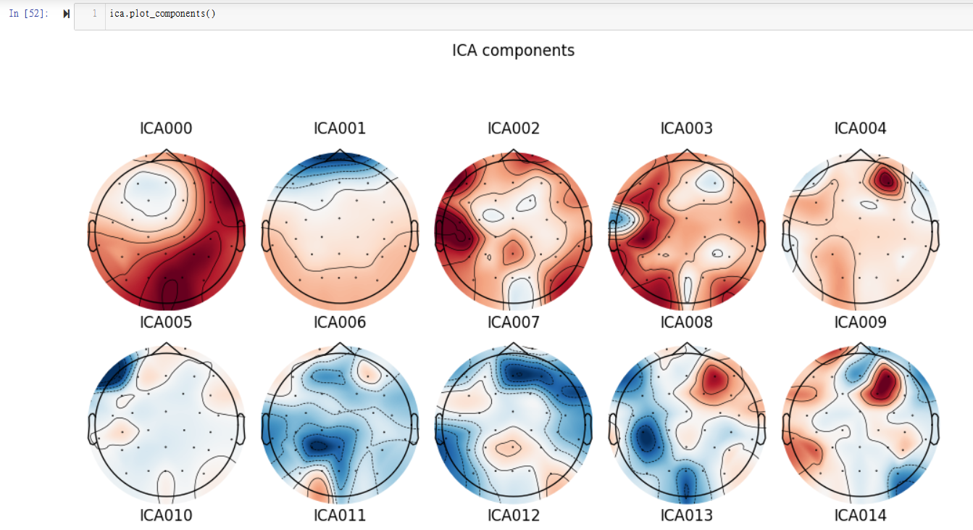
What I Learn and Practice
MNE python
I also use mne python to do ICA,
but has the same problem
I have referenced the tutorials on EEGlab,
but I'm still confused about it.

Slide 11
What I Learn and Practice
Wavelet Transform
I have also attempted wavelet transform with Python to apply it to a CNN model, but I am still encountering some unresolved data structure issues.

Slide 12
After Brain Hack School
Now I know how to implement the basic methods.
I still need to learn how to properly preprocess EEG signals so that I can apply different feature extraction methods and achieve the desired result.
I will continue learning and completing this project after the course ends.

Slide 13
Thank you
for your listening

